Slide 1
Linear droop control

Slide 2
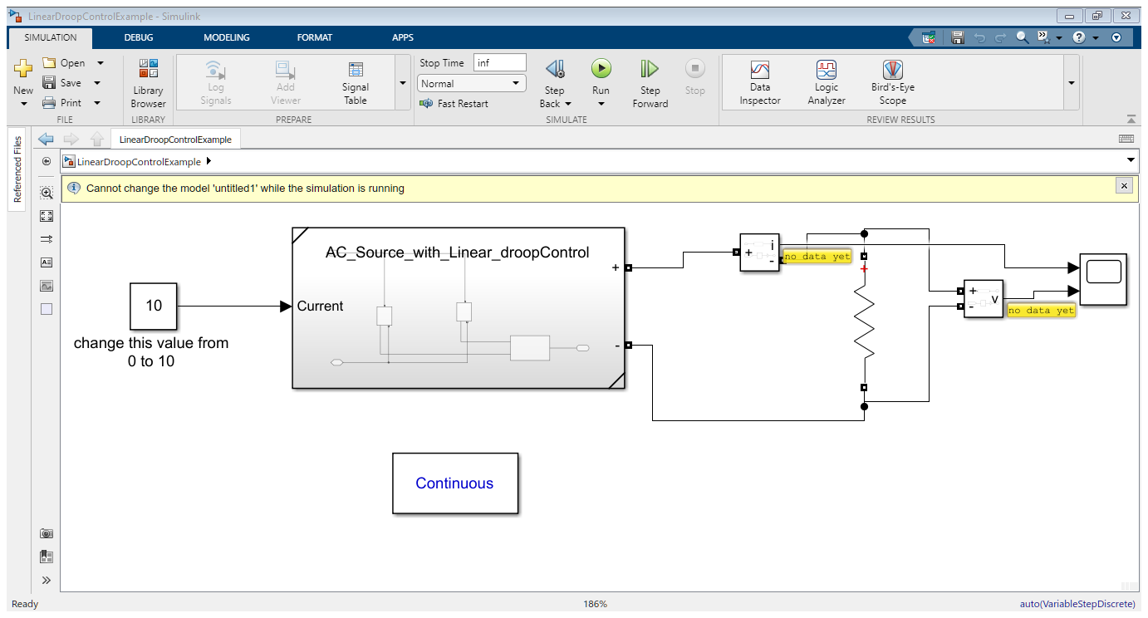

Slide 3
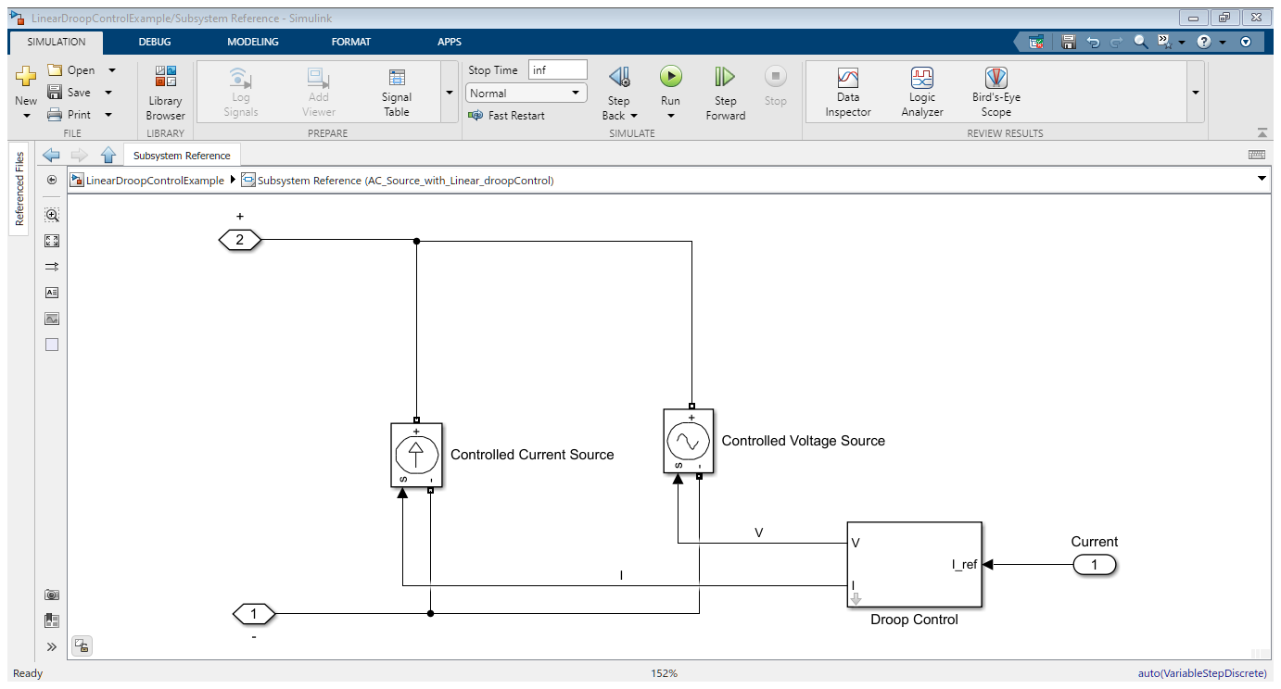

Slide 4
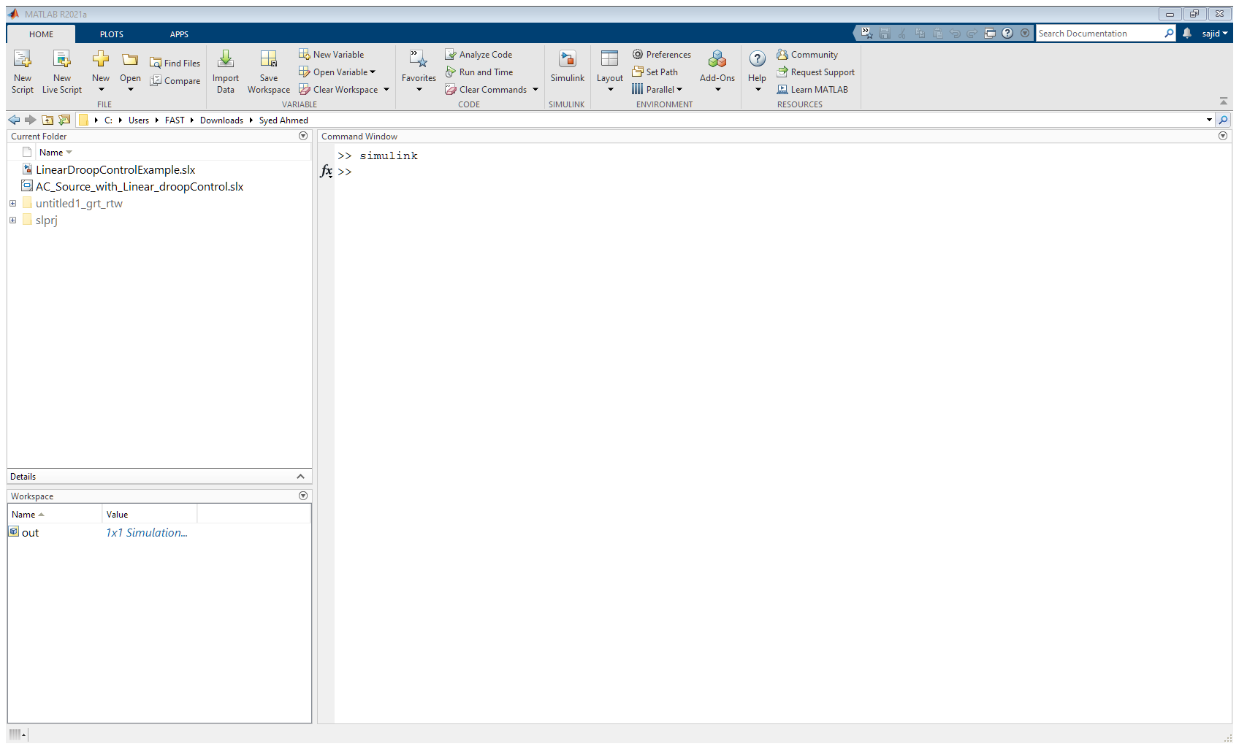

Keep these 2 files inside same directory(the same folder)

Slide 5
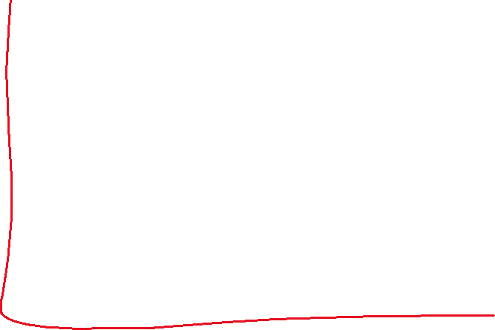
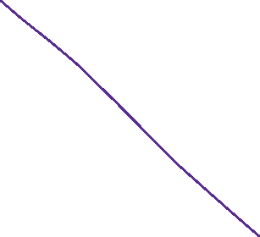
This is the slope I have implemented for you.
I hope you get the idea and do the rest of them
yourself.
Vnom=120v
Vrated=100v
Irated=10A

